Slide 1
Adult Procedural Moderate and
Deep Sedation:
A Training Program for
Emergency Medicine Physicians

Slide 2
Adult Procedural Sedation by the
Non-Anesthesiologist
Guidelines for adult procedural sedation promote safe and effective medical practice:
Many procedures are more tolerable for the patient, and easier for the provider, if the patient receives sedation.
In order to provide sedation safely, the American Society of Anesthesiologists (ASA) provides guidelines for patient selection and evaluation and in how we administer sedation, monitor patients and recover patients.
Completing this presentation and successfully taking the knowledge test are parts of the credentialing process for providing procedural sedation.
At UM SJMC, separate credentialing exists for adult procedural deep sedation and pediatric moderate sedation. No credentialing exists for pediatric deep sedation and an anesthesiology consult should be obtained in all patients 12 years of age or younger if it is determined that a deep level of sedation will be required.

Slide 3
Provider Credentialing for Adult Procedural Sedation
To perform a procedure while supervising a nurse providing moderate sedation, a provider must meet the following criteria
  Licensing and Training verification
    Hold an unrestricted state license (MD, DO, DPM, DDS, PA or NP)
    Hold current DEA and state CDS registrations
    Meet all other credentialing requirements
  Successfully complete sedation specific training and demonstrate competence
    Complete this presentation and successfully pass the accompanying test with 85% or greater
    Review the hospital sedation policy
    Providers must have current certification in ACLS (ER physicians excepted as this is a core competency of the specialty)

Slide 4
Maintaining Provider Credentialing for Procedural Sedation
Ongoing surveillance by the Performance Improvement Department is part of ongoing maintenance of credentials
    Number of cases performed
    Number of adverse events
    Nature and severity of adverse events
    Peer review of cases
Providers also must demonstrate maintenance of skills
    Completion of sedation competency every two years
      Completion of knowledge test (90% passing)
  Assessment of ongoing skills competency
    Determined by provider’s departmental chair

Slide 5
Objectives
At the completion of this Self-Study Guide, the applicant will be able to:
Assess, monitor, manage, evaluate, and document patient care before, during and after sedation analgesia.
Discuss techniques for administering pharmacologic agents, which will maintain the patient at the desired level of sedation and analgesia.
Appropriately manage patients regardless of the level of sedation obtained.
Discuss the rationale and process for ETCO2 monitoring.

Slide 6
Applications for Procedural Sedation
Some of the Diagnostic and Therapeutic procedures that are appropriate for sedation include:
  Endoscopies
  Cardiac Catheterization
  Radiologic Studies
  Bronchoscopies
  Dental procedures
  Various procedures in the ED setting

Slide 7
Sedation versus Analgesia
Sedation reduces the state of awareness
    Many sedatives produce amnesia, the inability to remember
    Benzodiazepines are sedative agents with no analgesic effects
Analgesia reduces or eliminates the perception of pain, most have sedative effects
    Opioids are primarily analgesics; examples include Morphine and Fentanyl

Slide 8
Continuum of Sedation
The American Society of Anesthesiologists and TJC define four levels of anesthesia:
    Minimal sedation (anxiolysis): A drug-induced state during which patients respond to verbal commands. This level of sedation may impair cognitive function and coordination. Minimal sedation does not affect ventilatory or cardiovascular function.
    2. Moderate sedation/analgesia (formerly called “conscious sedation”): A drug-induced depression of consciousness during which patients respond purposefully to verbal commands, either alone or with light tactile stimulation. The patient requires no interventions to maintain a patent airway, and spontaneous ventilation is adequate. Cardiovascular function is usually maintained.

Slide 9
Continuum of Sedation
The American Society of Anesthesiologists and TJC define four levels of anesthesia:
Deep sedation/analgesia: A drug-induced depression of consciousness during which patients cannot be easily aroused but respond purposely to repeated or painful stimulation. This level of sedation may impair the patient’s ability to independently maintain ventilatory function. A patient may require assistance to maintain a patent airway, and spontaneous ventilation may be inadequate. Cardiovascular function is usually maintained.

Slide 10
Continuum of Sedation
The American Society of Anesthesiologists and TJC define four levels of anesthesia:
General anesthesia: A drug-induced loss of consciousness during which patients cannot be aroused even by painful stimulation. It does not include local anesthesia. General anesthesia frequently impairs the ability to independently maintain ventilatory function. Patients often require assistance to keep their airway patent. Patients may need positive-pressure ventilation because general anesthetics may depress spontaneous ventilation and neuromuscular function. General anesthesia may impair cardiovascular function.

Slide 11
Continuum of Depths of Sedation
Patients may move between states of sedation based on medications administered and stimulation received.
Providers should be prepared to rescue patients
if sedation is deeper than intended.
Level of consciousness
Awake
Minimal
sedation
(anxiolysis)
Moderate
(conscious)
sedation
Deep
sedation
General
anesthesia
Protective reflexes
Present
Present
Present/
potential loss
Probable
loss
Total
loss

Slide 12

Moderately Sedated
A Moderately Sedated Patient:
Looks like this and is arousable to verbal stimuli, able to answer your questions and respond to verbal commands (like “take a deep breath”).
Is able to maintain his/her own airway and breathes adequately, taking full,
not shallow breaths.

Slide 13
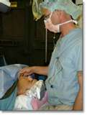
Moderate to Deep Sedation
If the patient goes from Moderate Sedation to Deep Sedation, the person monitoring the patient:
Makes the MD doing the procedure aware
Helps patient maintain open airway
(oral airway, head tilt-chin lift, jaw thrust)
Assists with ventilations via Ambu Bag
& Mask with 100% O2 as needed
Administers reversal agents if needed
Supports BP & cardiac rhythm with fluids
and meds if needed

Slide 14
Undesired Effects of Deep Sedation
Airway obstruction (tongue)
Respiratory depression->Apnea
Hypotension
Agitation
Unarousable sleep
Significantly slurred speech
Nystagmus

Slide 15
Consent for Procedure + Sedation
Physician to explain risk & benefits to patient & family & obtain informed consent
Obtain patient signature prior to administration of any sedative or opioid
    Include time and date
Witness’s signature
    Time and date should match patient’s
    Witnessing patient signed consent

Slide 16
ASA Classification
ASA Classification is completed by the physician
ASA I - Healthy Patient
ASA II - Patient with mild systemic disease
ASA III - Patient with severe systemic disease
(For example; history of CVA, DM w/ end organ damage, CRF w/ dialysis, oxygen dependent COPD, CABG, multiple Cardiac Stents, Cardiomyopathy, MI, Cardiac or Respiratory Arrest, Pacemaker→Procedure MD to consult Anesthesia Provider prior to procedure → Procedure may become Monitored Anesthesia Care (MAC) or General Anesthesia, both provided by Anesthesiologist)

Slide 17
ASA Classification
These ASA levels require a Anesthesia Qualified Physician:
ASA IV – Patient with Severe Systemic Disease that is a constant threat to life
ASA V – Patient is moribund – not expected to survive without the procedure
ASA VI – Patient declared brain dead whose organs are being removed for donor purposes

Slide 18
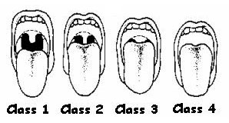
Airway Assessment
The Mallampati score predicts ease of intubation. Class 1 and 2 are likely easy to intubate while class 3 and 4 may be difficult to intubate.
Mallampati Classification
Scoring is as follows:
Class 1: Full visibility of tonsils, uvula and soft palate
Class 2: Visibility of hard and soft palate, upper portion of tonsils and uvula
Class 3: Soft and hard palate and base of the uvula are visible
Class 4: Only hard palate visible
Notes:
Actually, the amount of the posterior pharynx you can visualize is important and correlates with the difficulty of intubation.
Visualization of the pharynx is obscured by a large tongue (relative to the size of the mouth), which also interferes with visualization of the larynx on laryngoscopy. The Mallampati Classification is based on the structures visualized with maximal mouth opening and tongue protrusion in the sitting position.

Slide 19
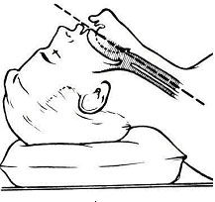
Airway Assessment
Examine the patient and look for other features that my predict airway obstruction or difficult intubation.
Morbid obesity
Hx OSA, snoring
Small mouth opening (<3 fingerbreadths)
Large tongue
Large overbite
Short neck
Arthritis of neck
Previous tracheostomy
History of neck irradiation

Slide 20
Identify Risk Factors
Potential risk factors identified during
patient history & physical:
Communication barriers
Pregnancy
Hx drug, alcohol, tobacco use
Lack of patient prep (patient unable to be NPO)
Use of opioids w/in 24 hours of procedure
Previous adverse experience with sedation or anesthesia
Recent cold, flu or fever
Unstable Vital Signs
(BP, HR, Rhythm, RR)
GI Bleed
Notes:
Inability to communicate or cooperate as in developmentally delayed or language barrier (ESOL, deaf,)

Slide 21
NPO Guidelines
Prior to Non-emergent procedure no:
    8 hours – Solid food
    6 hours – Light meal or particulate liquids
    4 hours – Breast milk
    2 hours – Clear liquids
Emergency Dept. procedures: Assume full stomach, anticipate increased risk of aspiration
If the patient is not NPO, consider the risk of aspiration vs the risk of waiting the appropriate time or waiting for an anesthesia provider. Expected level of sedation required to complete procedure should also be factored into the decision.

Slide 22
Pre-Procedure Assessment
Consent ----------------------→
ASA Classification -----------→
Mallampati Score ------------→
NPO status -------------------→
Patient History & Physical ---→
Includes the procedure (no abbreviations), plan for sedation, & signatures
Physician identifies candidates appropriate for Procedural Sedation
Physician identifies patient with potential airway problem
Identifies patient with potential for aspiration
Identifies conditions which affect patient response to Procedural Sedation

Slide 23
Equipment & Training Required
Always ensure that rescue equipment is readily available.
Equipment
Patent IV
Reversal Agents
Monitor-continuous ECG rhythm, BP, O₂ sat, capnography
Oxygen via NC/Mask
BagValveMask (BVM)
Oral & Nasal Airways
Laryngeal mask airway
Intubating equipment
Operating Suction
Stethoscope
Code Cart with Defibrillator
Cricothyrotomy Tray
Training
ACLS, or Code Blue Level 2 certified RN who has NO additional responsibilities other than administering sedation & monitoring the patient
  Sedation and monitoring must be provided by a Registered Nurse who has successfully completed the moderate sedation education and competency

Slide 24
Intra-Procedure
Administering Meds & Monitoring the Patient Intra-Procedure
Baseline vital signs (BP, HR, Respiration rate & depth, SAO₂, ETCO₂, Sedation Level, & Pain Score)
    Monitor the above parameters every 5 minutes with continuous ECG rhythm
Administer IV meds over recommended time periods, giving meds chance to take effect
Titrate meds according to above parameters
Assess level of sedation & pain score by asking patient to answer questions and to take deep breaths

Slide 25
Sedation Scale
Richmond Agitation and Sedation Scale (RASS)
+4 Combative
+3 Very Agitated
+2 Agitated
+1 Restless
0 Alert and Calm
-1 Drowsy
-2 Light Sedation
-3 Moderate Sedation
-4 Deep Sedation
-5 Unarousable

Slide 26
Intra-Procedure Monitoring
Observe for signs and symptoms of airway obstruction: tongue, soft pallate collapse, snoring, loss of pharyngeal and laryngeal reflexes
Skin Condition: color, turgor, temperature
Observe Neurological Activity: Pupil activity, eyelid movement

Slide 27
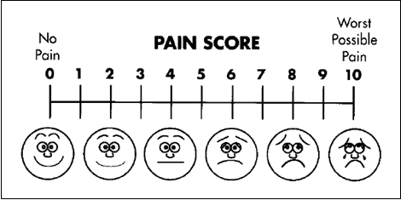
Pain Score
The goal is comfort with safety
Pain score of 3 or less
Vital signs stable
Airway open, respirations adequate

Slide 28
Procedural Sedation-RN Administered
Medications the Moderate Sedation Competent RN may administer:
Verbal sedation - reassuring the patient
Opioids (Fentanyl, Morphine) produce analgesia
Benzodiazepines (Midazolam, Diazepam, Lorazepam) produce amnesia
Combined (small doses of both an opioid and a benzodiazepine) work synergistically to produce analgesia and amnesia=moderate sedation
Ketamine – dissociative sedation

Slide 29
Opioids
Opioids remain the gold standard for treatment of severe pain.
    Fentanyl is a synthetic opioid. It is 50 to 100 times more potent and has a shorter duration than morphine.
        An unusual complication, chest wall rigidity, may occur with large doses (usually >5 microgram/kg) given rapidly. You may need to use neuromuscular blockade and tracheal intubation to treat this complication.
  Morphine may also be used. Due to its histamine release, use caution in patients with Asthma.

Slide 30
Opioids
The most common adverse effects of opioids are:
    RESPIRATORY DEPRESSION
    Bradycardia
    Pruritis
Hemodynamically compromised patients (i,e, dehydration) may develop hypotension.

Slide 31
Benzodiazepines
Benzodiazepines are sedative hypnotic agents that produce amnesia.
Benzodiazepines can cause respiratory depression, especially with concomitant use of barbiturates or opioids. Occasionally a paradoxical excitatory reaction occurs. Hypotension occurs less frequently with these drugs than with barbiturates.
For patients who are hemodynamically unstable (i.e., hypotensive or hypovolemic), you should decrease the recommended dose (typically by 50%).

Slide 32
Deep Sedation Medications
The following medications may NOT be used for moderate sedation and must be MD administered (RESTRICTED TO ED FOR PROCEDURAL DEEP SEDATION):
Propofol and Etomidate are administered by Anesthesia Qualified Physicians (Anesthesiologists, Intensivists in ICU & NICU, Emergency Dept. Physicians)
Due to narrow therapeutic window these agents may only be used for procedural sedation when the intended goal is DEEP sedation
These patients also require monitoring during the recovery to pre-procedure status by the RN
**RN may NOT administer Propofol or Etomidate**

Slide 33
Dissociative Anesthetics (Ketamine)
Ketamine is a dissociative agent that produces a cataleptic (i.e., trance- like) state in which the eyes remain open with a slow nystagmic gaze. Patients are non-communicative but they appear awake.
  Can produce general anesthesia when given in larger doses. Its duration of action is variable (15 to 60 minutes). Use the lower dose range for hemodynamically compromised patients.
  Adverse effects of Ketamine include increased systemic (BP), intracranial, and intraocular pressures; hallucinogenic emergence reactions ; laryngospasm; and excessive airway secretions.
  Produces potent analgesia and rapid sedation; it preserves respiratory drive and airway protective reflexes when used in appropriate doses.
  Given in 10-20mg incremental doses IV for moderate and deep sedation
  CMS- Centers for Medicare & Medicaid Services

Slide 34
Naloxone (Narcan)
Naloxone is the prototypical narcotic receptor antagonist. When you suspect that respiratory depression is caused by opioid effect, use naloxone in small doses (0.005-0.01mg/kg). This dose will maintain some analgesia for the underlying pain.
If the initial dose is ineffective, repeat titrated doses every 1 to 2 minutes.
The maximum dose is 0.1mg per dose. You may give naloxone by the IV, IM or tracheal route.
(Note that this dose is intentionally much lower than the dose recommended for immediate and full reversal of narcotic poisoning.)

Slide 35
Flumazenil (Romazicon)
Flumazenil, a benzodiazepine receptor antagonist, can reverse benzodiazepine-induced respiratory depression and paradoxical excitatory reactions. It is ineffective for opioid narcotic reversal.
Providers generally give flumazenil in doses of 0.01 to 0.02 mg/kg; you may repeat these doses every 1 to 2 minutes up to a maximum dose of 1 mg.
Use caution if the patient has a history of seizures because Flumazenil may induce seizures.

Slide 36
Recognize and Rescue
With recognition of adverse effects, stop the procedure
in order to stabilize and support the patient.
If respiratory depression or airway obstruction occurs during sedation, you should immediately open and clear the airway. Then provide assisted ventilation and 100% oxygen as needed.
If you decide to give a reversal agent, consider the following agents.
    For opioid narcotic reversal: Naloxone (Narcan)
    For benzodiazepine reversal: Flumazenil (Romazicon)
Beware of the adverse effects of reversal agents. Weigh the benefit of immediate reversal against provision of respiratory assistance until the adverse effects of the narcotic or benzodiazepine dissipate.
Note that the half-life of the reversal agent is frequently shorter than the half-life of the sedative agent. Observe for recurrence of sedation after the effects of the reversal agent dissipate.

Slide 37
Suggested Sequential Management of Airway Obstruction
Reposition the airway
Perform a jaw thrust
Insert oral airway
Call for help
Insert nasal airway
Insert supraglottic airway device (LMA)
Tracheal intubation
Surgical airway (percutaneous crycothyrotomy)

Slide 38
Post-Procedure Care
The expectation of post-procedure care is to verify the patient’s return to baseline status.
Constant observation with vital signs at least every 15 minutes until “Recovery Phase Completion Criteria” are met.
The period of time in “Recovery Phase” should be at least 90 minutes after the last dose of reversal agent if given.

Slide 39
Recovery Phase
Completion of recovery phase criteria:
  Alert, oriented x 3
  No major discomfort
  No active bleeding
  Stable VS (within normal range or 20% of pre-procedure VS)
  Adequate respirations SaO₂ > 90% on room air

Slide 40
Criteria for Discharge Home
Patient is alert and oriented X3 or sensorium is essentially the same as pre-procedure
Is ambulating without excessive dizziness; demonstrates good motor control or is back to pre-procedure status
Is without major discomfort or significant bleeding
Has stable vital signs for 30 minutes
Tolerates PO fluids without nausea or vomiting, or nausea under control with medication

Slide 41
Discharge Instructions
Receives written discharge instructions and a verbal review with their responsible adult companion
Patient may not drive for 24 hours
Instruct patient to avoid making any legally binding decisions/sign legal documents or operate heavy equipment for at least 24 hours
No alcoholic beverages for at least 24 hours

Slide 42
Post Procedure Documentation
CMS requires all of the following to be included in a post procedure note:
    Respiratory function, including respiratory rate, airway patency, and oxygen saturation
    Cardiovascular function, including pulse rate and blood pressure
    Mental status
    Temperature
    Pain
    Nausea and vomiting
    Post operative hydration

Slide 43
CO₂ is a Ventilation Vital Sign
There are two components to breathing
    Oxygenation – measured by SpO₂
    Ventilation – elimination of CO₂ – measured by exhaled CO₂
When breathing room air, oxygenation and ventilation are closely matched and measuring SpO₂ provides a good surrogate for ventilation.
When supplemental oxygen is used, SpO₂ may be maintained while ventilation is inadequate. Treating a low SpO₂ by increasing oxygen flow rate may mask increasing hypercarbia.
Monitoring CO₂ in addition to SpO₂ provides a direct measure of ventilation and early detection of airway obstruction.
Monitoring of CO₂ is required by the Joint Commission and by the American Society of Anesthesiologists whenever moderate sedation is performed.

Slide 44
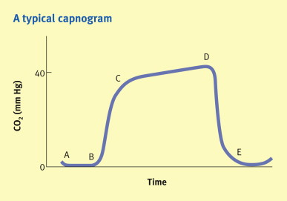
The End Tidal CO₂ Curve
A-B Inhalation
B-C Dead Space exhalation
C-B Alveolar Exhalation
D-E End Exhalation

Slide 45
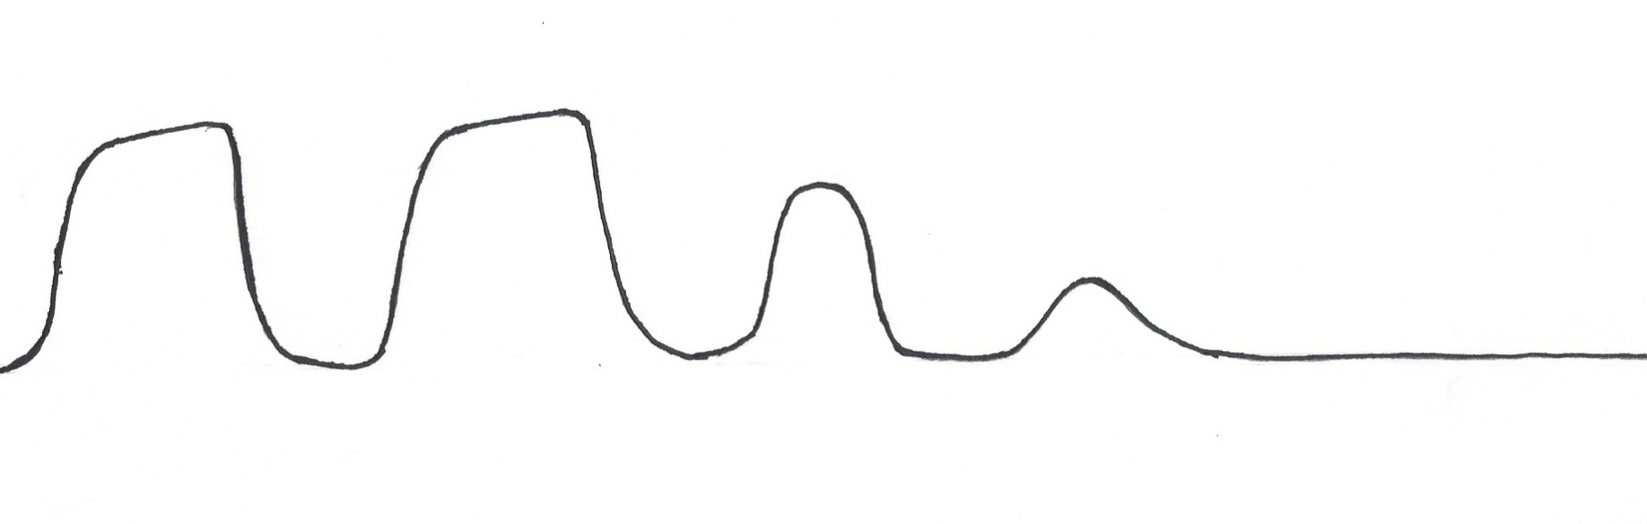
CO₂ in Clinical Use
Early detection of hypoventilation and apnea
CO₂ fall off may precede SpO₂ drop by as much as a minute
SpO₂ 100%

Slide 46
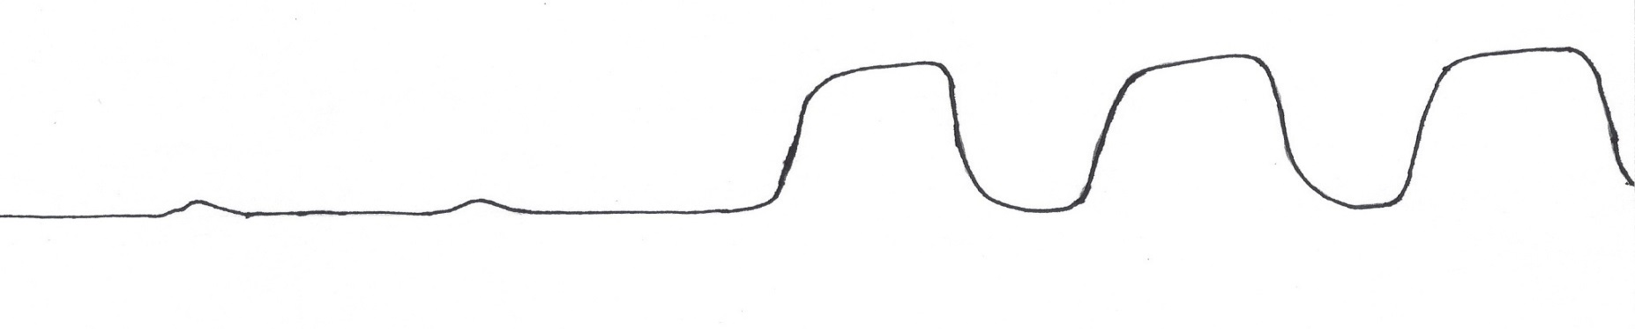
CO₂ in Clinical Use
CO₂ provides early confirmation that ventilation has been restored
SpO₂ will be restored in 10 – 20 seconds
SpO₂ 81%

Slide 47
CO₂ Interpretation
With sampling from nasal cannula, the patients true ET CO₂ will be greater than that shown on the monitor because room air is entrained in the sample stream.
The respiratory pattern is more important than the numerical value.
The CO₂ waveform may be affected by mouth breathing or occlusion of the aspiration port on the nasal cannula.
CO₂ sampling doesn’t replace the requirement to Observe and Examine the Patient

Slide 48
Deep Sedation is Anesthesia
CMS defines Deep Sedation as MAC Anesthesia
Anesthesia may only be provided by:
  A Physician (MD, DO)
  A Dentist
  A Podiatrist
The only exception is within the Emergency Dept.
  A board certified ED physician who is appropriately credentialed may provide Deep Sedation within the ED

Slide 49
Definitions of Deep and Dissociative Sedation
Deep sedation/analgesia: A drug-induced depression of consciousness during which patients cannot be easily aroused but respond purposely to repeated or painful stimulation. This level of sedation may impair the patient’s ability to independently maintain ventilatory function. A patient may require assistance to maintain a patent airway, and spontaneous ventilation may be inadequate. Cardiovascular function is usually maintained.
Dissociative sedation: A unique trancelike cataleptic state produced by ketamine and characterized by profound analgesia and amnesia. Airway reflexes, respiratory function and cardiovascular function are usually maintained.

Slide 50
Agents Used in Deep Sedation
Deep sedation may be produced by the same agents used for moderate sedation (e.g. midazolam and fentanyl)
Propofol and Etomidate are specifically used to produce deep sedation or general anesthesia. They may not be used to produce moderate sedation due to their narrow therapeutic window
Ketamine is used to produce moderate sedation, deep sedation or general anesthesia

Slide 51
Propofol
Propofol is a sedative/hypnotic agent without analgesic activity
Onset of action ~ 40 seconds
Titrate small amounts to desired effect
May cause respiratory depression, apnea > 60 seconds, hypotension, bradycardia, and airway obstruction
Synergistically acts to intensify the respiratory depression caused by opioids
Propofol has amnestic and anti-emetic properties
Recommended dosing is 1mg/kg bolus with repeat doses of 0.5mg/kg every 3-5 minutes
Dosing must be adjusted downward for patients with hemodynamic compromise, frail or elderly, patients receiving adjunct sedation meds, and patients at high risk for airway obstruction
Causes painful injection; larger veins preferred

Slide 52
Etomidate
Etomidate is a hypnotic drug without analgesic activity
Rapid onset (< 1minute), brief duration
Greater cardiovascular stability than propofol. Maintains heart rate, blood pressure and cardiac output
May cause apnea similar to propofol
Associated with nausea/vomiting
May cause adrenal suppression
May cause myoclonus
Recommended dosing 0.1-0.2mg/kg bolus followed by 0.05mg/kg boluses every 3-5 minutes
Causes painful injection; larger veins preferred

Slide 53
Ketamine
Ketamine produces dissociative sedation. This is a trance like state in which eyes may remain open and exhibit nystagmus. Patients are non-communicative but may appear awake.
Ketamine may be titrated IV (10 -20 mg increments) or may be given as a single IM dose (4-5 mg/kg for pediatrics, 6.5 mg/kg for adults).
Onset of action 30 seconds IV, 3-5 minutes IM.
Reduces cardiac contractility. Use with caution in patients with CM.
Maintains heart rate and blood pressure through sympathomimetic stimulation.
Maintains spontaneous respiration.
Causes vivid hallucinations, hypersalivation, increased intracranial and intraocular pressures, laryngospasm.
Relatively contraindicated in patients with psychosis.

Slide 54
Monitoring Deep and Dissociative Sedation
Moderate Sedation, Deep Sedation and General Anesthesia all require the same level of monitoring.
  Continuous 3 lead EKG, SpO₂ and ETCO₂, NIBP every 5 minutes.
  Qualitative monitoring of consciousness, respiration, and pain scale.

Slide 55
Post Procedure Care
Patient to be monitored to PACU standards.
As specified by Policy
  Supplemental oxygen as needed
  3 lead EKG, NIBP and SpO₂ monitoring every 15 minutes
  Pain medication and warming as needed
  Patient and family education

Slide 56
Post Procedure Documentation
CMS requires all of the following to be included in a post procedure note:
  Respiratory function, including respiratory rate, airway patency, and oxygen saturation
  Cardiovascular function, including pulse rate and blood pressure
  Mental status
  Temperature
  Pain
  Nausea and vomiting
  Postoperative hydration

Slide 57
When to consider consultation with the anesthesia department for deep sedation:
All ASA IV and ASA V patients
Patients with full stomachs, especially those at increased risk for aspiration (diabetics, obese, pregnant, substance abuse)
Patients at risk for airway obstruction (h/o OSA, morbidly obese, MPA Class III or IV, airway abnormalities)
Patients with communication barriers
Patients with a history of adverse experiences with anesthesia
Patients with unstable vital signs or active bleeding
Patients with severe heart valvular disease
Patients with severe pulmonary HTN
Any time it crosses your mind!

Slide 58
Review of Hospital Policy APC 20
Please review hospital policy APC 20: Procedural
Sedation Analgesia by Non-Anesthesia Provider
After review, complete the competency exam. A score of 85% is required to obtain the privilege.

